Slide 1


Essentials of an Effective Inbound Strategy

Slide 2
2
WHAT ARE THE FUNDAMENTALS OF INBOUND SUCCESS ?

Slide 3
INBOUND BEST PRACTICES
Use buyer personas.
Use the Buyer’s Journey.
Create remarkable content.
Leverage your content.

Slide 4
INBOUND BEST PRACTICES
Use buyer personas.
Use the Buyer’s Journey.
Create remarkable content.
Leverage your content.

Slide 5

BUYER PERSONAS
Semi-fictional representations of your ideal customer based on real data and some select educated speculation about customer demographics, behavior patterns, motivations, and goals.

Slide 6

CONDUCTING PERSONA RESEARCH
Buyer personas must be based off of
actual research, not assumptions.

Slide 7


SAMPLE PERSONA RESEARCH QUESTIONS
Persona Detail | Sample question toAsk
Role | What is your job role? Your title?
Company/Organization | What industry or industries does your company work/is your role in?
Goals | What are you working to accomplish?
Challenges | What are your biggest challenges?
Watering Holes | How do you learn about new information for your job?
Shopping Preferences | Do you use the internet to research vendors or products?

Slide 8

Start by interviewing your
current customers.

Slide 9

PERSONA NAME
BACKGROUND:
Basic details about persona’s role, key information about the persona’s company
Relevant background info
DEMOGRAPHICS:
Gender, age range, household income (consider a spouse’s income, if relevant)
IDENTIFIERS:
Buzzwords & mannerisms
GOALS:
Persona’s primary & secondary goal
CHALLENGES:
Primary and secondary challenge to persona’s success
HOW WEHELP:
How you solve your persona’s challenges & help achieve their goals
COMMON OBJECTIONS:
Identify the most common objections your persona will raise during the sales process
REAL QUOTES:
Include a few real quotes (taken during interviews) that well represent your persona to make it easier for employees to relate to/understand to them

Slide 10

HR BLAST - SAMPLE SALLY
BACKGROUND:
Head of HR, married with 2 children (10 and 8)
Worked at same company for 10 years; worked up from HR Associate
DEMOGRAPHICS:
Skews female, age 30-45, suburban, dual HH Income: $140,000
IDENTIFIERS:
Calm demeanor, usually assistant screening calls, wants collateral mailed/printed
GOALS:
Keep employees happy and turnover low, support legal and finance teams
CHALLENGES:
Getting everything done with a small staff, rolling out changes to the entire company
HOW WEHELP:
Make it easy to manage all employee data in one place
Integrate with legal and finance systems
COMMON OBJECTIONS:
Worried will lose data moving to a new system, doesn’t want to have to train the entire company on it.
REAL QUOTES:
“It’s been difficult getting company-wide adoption of new technologies in the past.”
“I’ve had to deal with so many painful integrations with other departments’ databases and software.”

Slide 11
INBOUND BEST PRACTICES
Use buyer personas.
Use the Buyer’s Journey.
Create remarkable content.
Leverage your content.

Slide 12
THE BUYER’S JOURNEY
Awareness
Stage
Consideration
Stage
Decision
Stage

Slide 13
THE BUYER’S JOURNEY
Awareness
Stage
Consideration
Stage
Decision
Stage

Slide 14
THE BUYER’S JOURNEY
Awareness
Stage
Consideration
Stage
Decision
Stage

Slide 15
THE BUYER’S JOURNEY
Awareness
Stage
Consideration
Stage
Decision
Stage

Slide 16
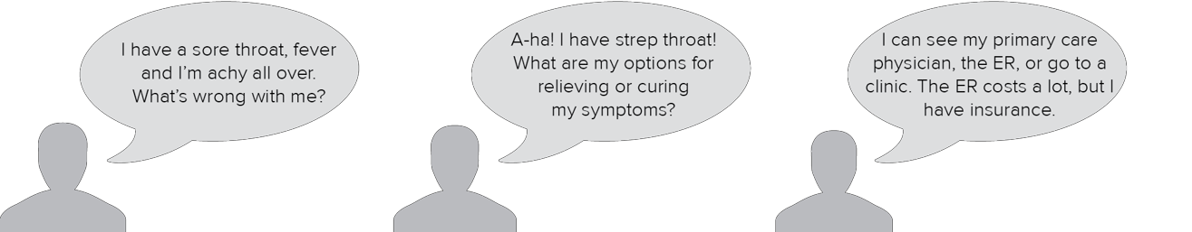
THE BUYER’S JOURNEY
Awareness
Stage
Consideration
Stage
Decision
Stage

Slide 17
THE BUYER’S JOURNEY
Awareness
Stage
Consideration
Stage
Decision
Stage

Slide 18
IF YOU WERE TO CREATE A BLOG POST ABOUT YOUR PRODUCT OR SERVICE, WHERE WOULD IT FALL INTO THE BUYER’S JOURNEY?
Awareness stage
Consideration stage
Decision stage

Slide 19
IF YOU WERE TO CREATE A BLOG POST ABOUT YOUR PRODUCT OR SERVICE, WHERE WOULD IT FALL INTO THE BUYER’S JOURNEY?
Awareness stage
Consideration stage
Decision stage

Slide 20
IF YOU WERE TO CREATE A BLOG POST ABOUT YOUR PRODUCT OR SERVICE, WHERE WOULD IT FALL INTO THE BUYER’S JOURNEY?
Awareness stage
Consideration stage
Decision stage

Slide 21
IF YOU WERE TO CREATE A BLOG POST ABOUT YOUR PRODUCT OR SERVICE, WHERE WOULD IT FALL INTO THE BUYER’S JOURNEY?
Awareness stage
Consideration stage
Decision stage

Slide 22
IF YOU WERE TO CREATE A BLOG POST ABOUT YOUR PRODUCT OR SERVICE, WHERE WOULD IT FALL INTO THE BUYER’S JOURNEY?
Awareness stage
Consideration stage
Decision stage
But wait! This was a trick question!

Slide 23
WHEN CREATING CONTENT, KEEP IT EDUCATIONAL.
Not educating your buyer personas on who you are and what you do,
but educating them on their problems and solutions to those problems.

Slide 24
INBOUND BEST PRACTICES
Use buyer personas.
Use the buyer’s journey.
Create remarkable content.
Leverage your content.

Slide 25
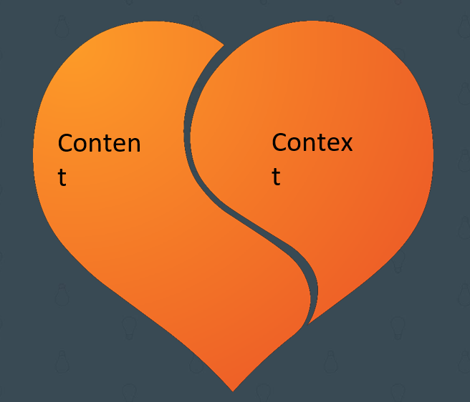
Inbound Marketing =Content +Context

Slide 26
CONTEXT
Who are you creating content for?

Slide 27
INBOUND BEST PRACTICES
Use buyer personas.
Use the Buyer’s Journey.
Create remarkable content.
Leverage your content.

Slide 28
Distribution makes content relevant.

Slide 29






LEVERAGING CONTENT VIA DISTRIBUTION
The right distribution technique gets the right content in front of the right person at
the right time.
Website
pages
Business
blog
Social
media
Landing
pages
Calls-to-
action
Marketing
emails

Slide 30
INBOUND BEST PRACTICES
Use buyer personas.
Use the Buyer’s Journey.
Create remarkable content.
Leverage your content.

Slide 31
THANK YOU
THANK YOU

